Slide 1
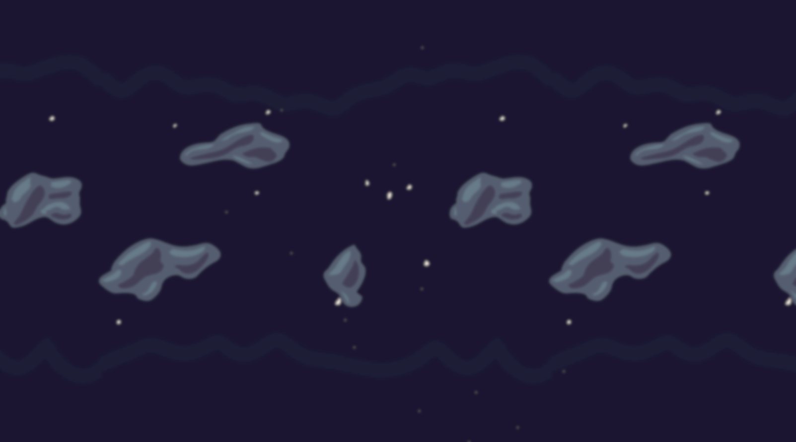
This is Gravity
A game where you go through puzzles by manipulating gravity.

Slide 2
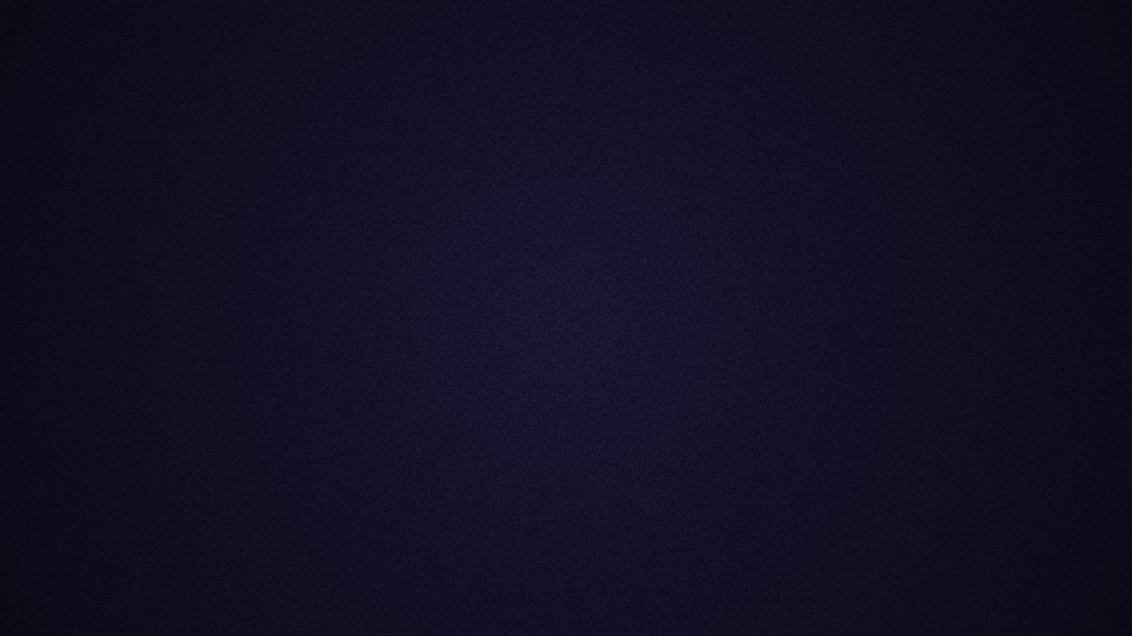
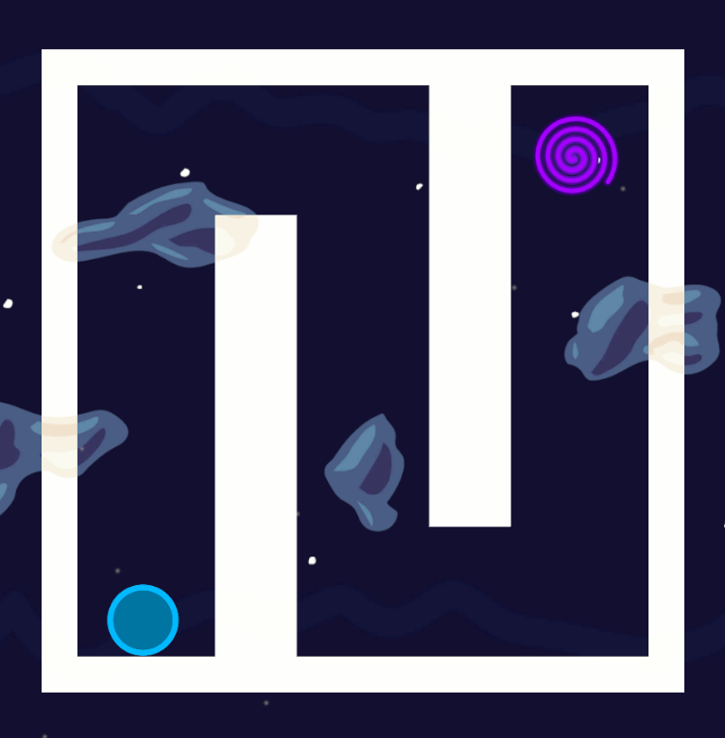
Idea
There are few maps that each contain obstacles, player and a portal.
To complete a level, you need to move the player to the portal. This is done by rotating the map’s gravity.
This idea fits the theme, because rotating the maps gravity is manipulation of an unseen force.

Slide 3

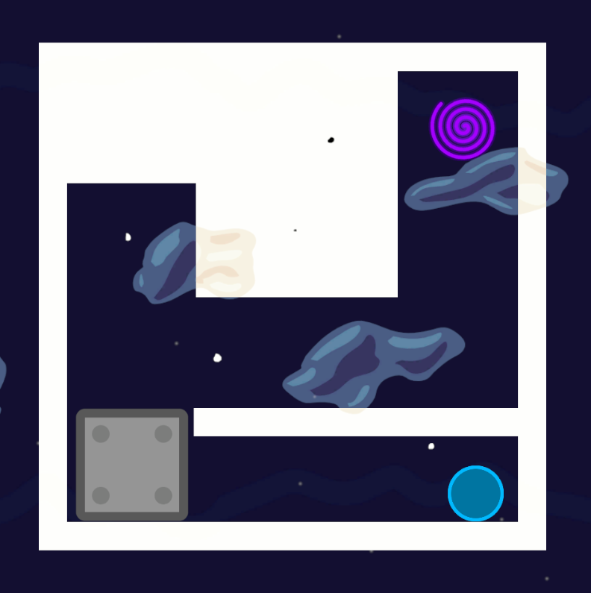
Core Mechanics
You can rotate the map’s gravity by 90 degrees to either left or right.
To finish a level, you need to guide the player to the portal in a specific amount of gravity rotations.
There is a reset button for the level, if you get into an impossible state.

Slide 4
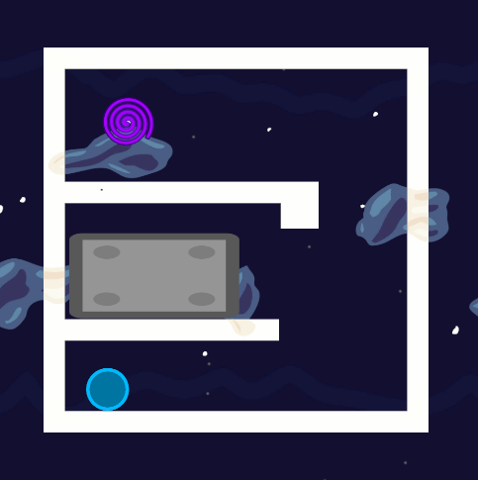
Tutorial
A
Rotate gravity to left by 90°
D
Rotate gravity to right by 90°
ESC
Back to Menu

